Slide 1
JFET Exercise

Slide 2
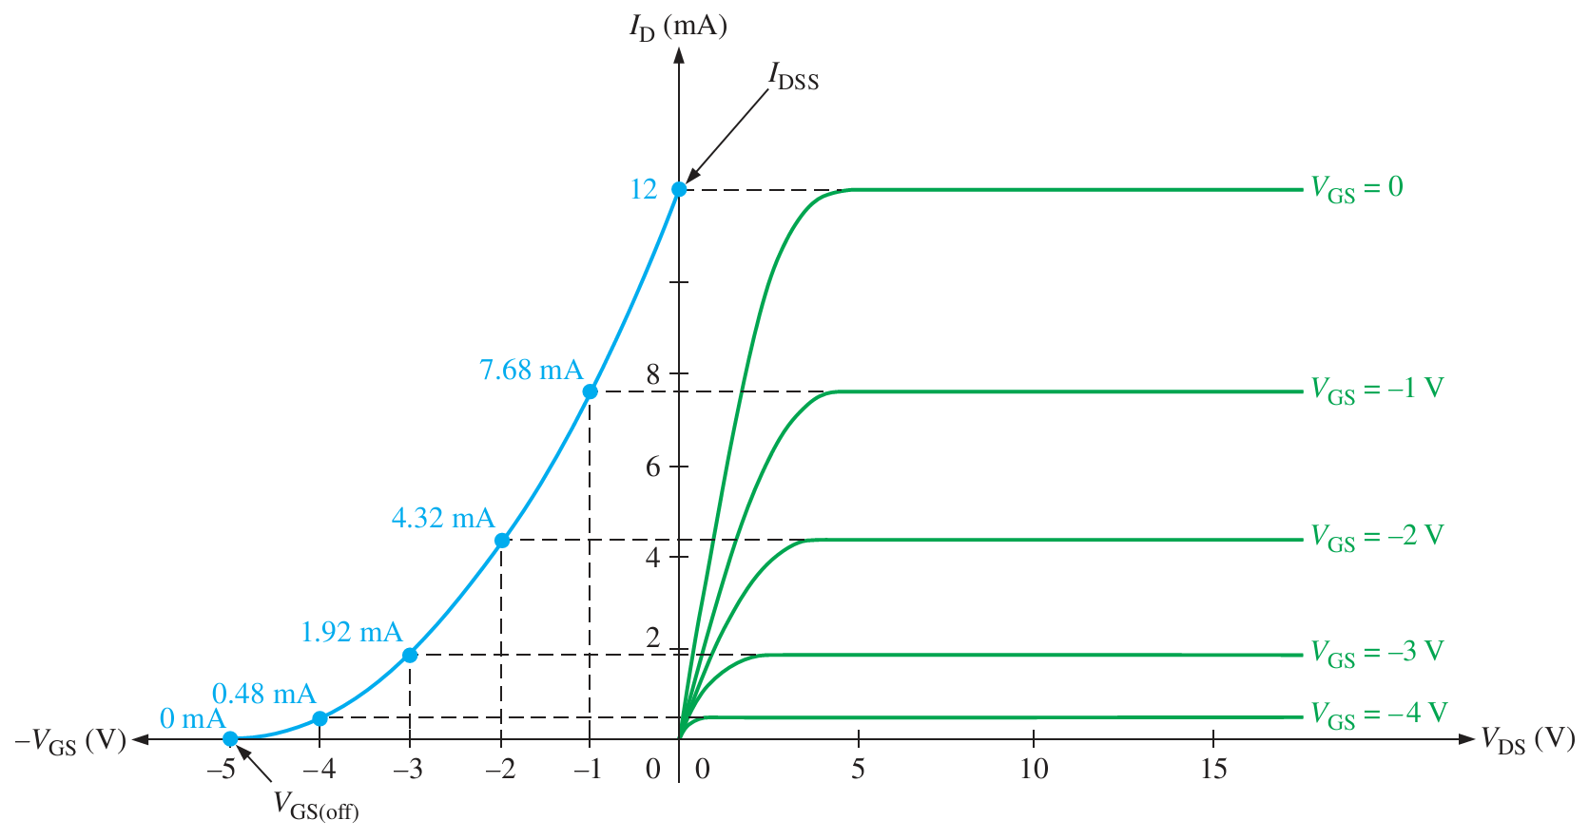
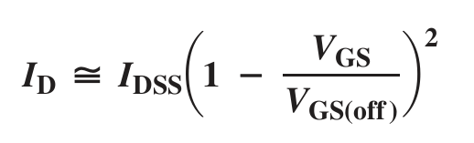
Remind…
Breakdown
Saturation
Pinch-off voltage
Cut off

Slide 3
For a JFET, the value of V_{DS} at which I_{D} becomes essentially constant is the
pinch-off voltage.
cutoff voltage.
breakdown voltage.
ohmic voltage.

Slide 4
A JFET data sheet specifies V_{GS(off)} = –10 V and I_{DSS} = 8 mA. Find the value of I_{D} when V_{GS} = –3 V.
2mA
1.4mA
4.8mA
3.92mA

Slide 5
Find I_{D}
A JFET data sheet specifies V_{GS(off)} = –6 V and I_{DSS} = 8 mA. Find the value of I_{D} when V_{GS} = –3 V.
2mA
4mA
8mA
None of these above

Slide 6
On the drain characteristic curve of a JFET for V_{GS} = 0, the pinch-off voltage is
below the ohmic area.
between the ohmic area and the constant current area.
between the constant current area and the breakdown region.
above the breakdown region.

Slide 7
The value of V_{GS} that makes I_{D} approximately zero is the
pinch-off voltage.
cutoff voltage.
breakdown voltage.
ohmic voltage.

Slide 8
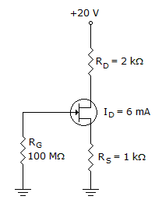
What is the value of I_{G}
0mA
2mA
4mA
6mA
Notes:
0mA

Slide 9
Determine VDS
0V
2V
4V
-2V

Slide 10
Determine the value of V_{S}.
20V
8V
6V
2V

Slide 11
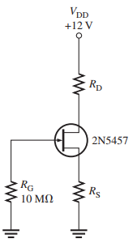
A self-biased n-channel JFET has a V_{D} = 6 V. V_{GS} = –3 V. Find the value of V_{DS}.
In a self bias configuration VG = 0V and there is a Resistor RS, connected to the Ground

Slide 12
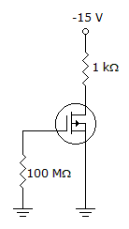
I_{D} = 6 mA. Calculate the value of V_{DS}
-9V
9V
6V
3V

Slide 13
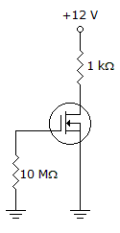
Refer to the given figure. I_{D} = 6 mA. Calculate the value of V_{DS}.
-6V
6V
12V
-3V

Slide 14
Refer to figure given below. Determine the value of V_{GS}.
-20V
-8V
-6V
-2V

Slide 15
What type(s) of gate-to-source voltage(s) can a depletion MOSFET (D-MOSFET) operate with?
Zero
Positive
Negative
Any of the above

